Slide 1
API and Python training
Session 9

Slide 2
This session’s agenda
Open API specification (Swagger)
Connexion module
Re-writing API server using Connexion
Swagger UI console
Demo
Training summary

Slide 3
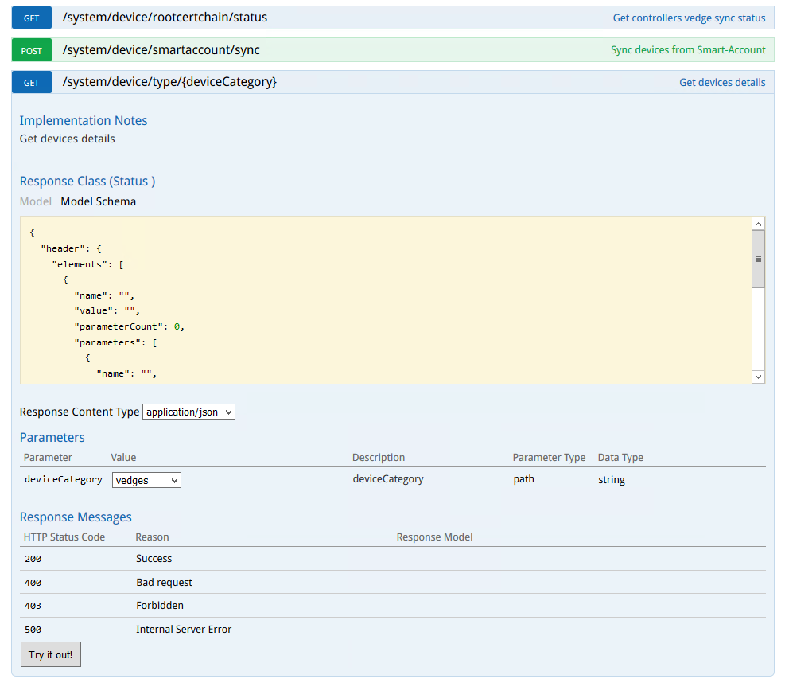
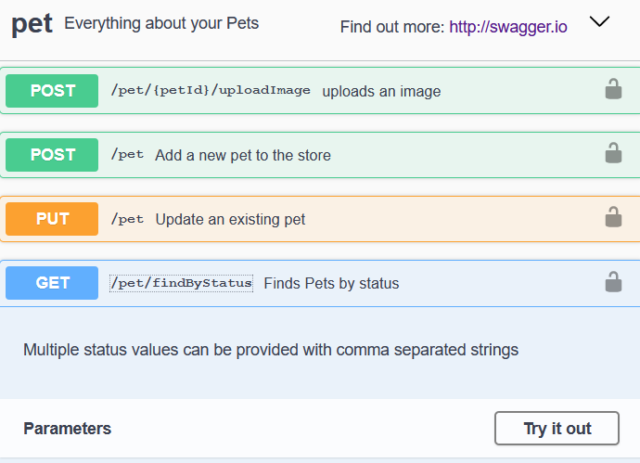
Open API specification (Swagger)
The OpenAPI Specification (OAS) defines a standard interface description for REST API
Describes API services and is represented in either YAML or JSON formats
Removes guesswork in calling a service
Human and machine readable
Two main versions – 2.0 (also known as Swagger) and newer 3.0 and 3.1
Can include interactive documentation (Swagger UI)
Check the doc:
Examples:
https://petstore.swagger.io/ Cisco vManage controller --->
https://github.com/OAI/OpenAPI-Specification/blob/master/versions/2.0.md
https://swagger.io/resources/articles/documenting-apis-with-swagger/

Slide 4
Connexion module
One of many tools which can help you documenting REST API
Connexion is a framework on top of Flask (but other servers can also be used)
Doesn’t generate specs based on the code, but you refer your existing Python functions in the spec
Write an OpenAPI specification in YAML file and map the endpoints to your Python functions
Validates requests and endpoint parameters automatically
Can handle basic and OAuth 2 token-based authentication
Provides Swagger UI console
install with pip:
pip install connexion
pip install connexion[swagger-ui]
https://connexion.readthedocs.io/en/latest/
https://github.com/zalando/connexion

Slide 5
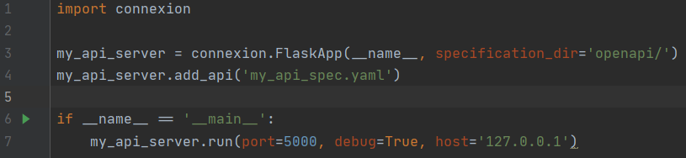
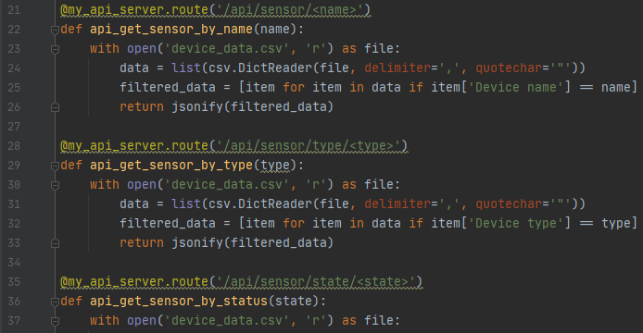
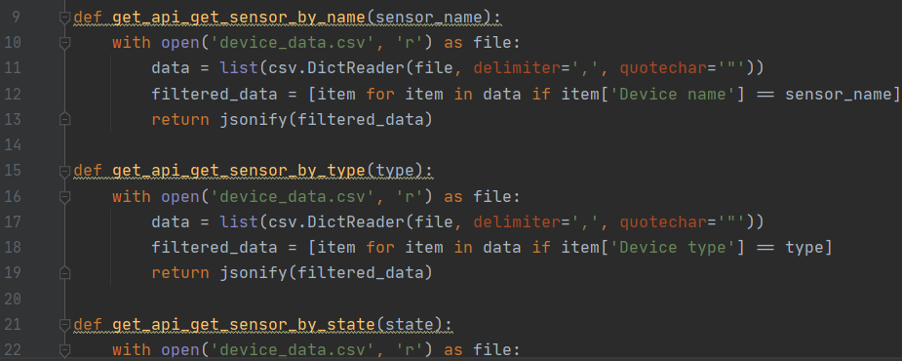
Re-writing API server
As it uses Flask, the syntax to run the server and its parameters is very similar (Line 7)
Define YAML specification file (Line 4)
You can put this file in a separate directory, add specification_dir parameter (Line 3)
In the file with Python functions handling API requests, you don’t need to define Flask routes anymore
Note lines 21, 28, 35 – defining routes: No Flask routes, only function definitions:

Slide 6
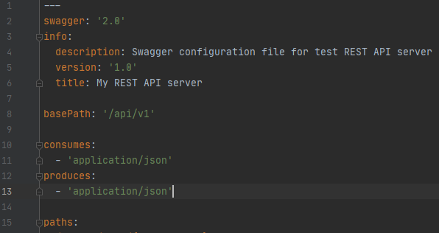
YAML Specification file – common settings
The file you defined as API specification file when started API server
Two main parts – common settings and paths
Common settings example:
Note basePath is added to all API endpoints,
<server><basePath><endpointPath>
----------->
Next, you define individual paths -------->

Slide 7
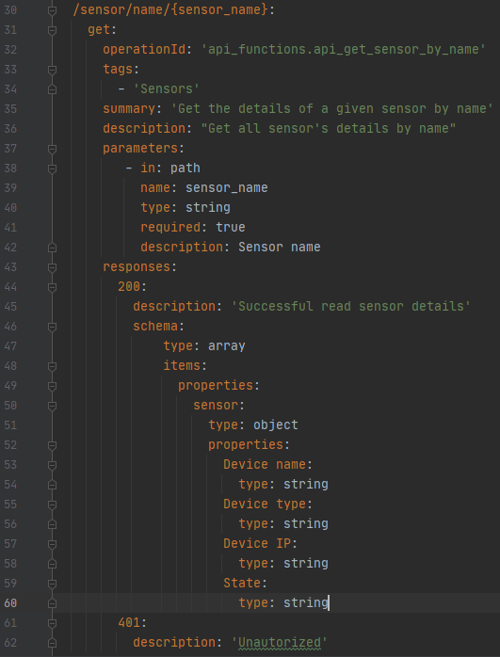
YAML Specification file - paths
Line 30 – path, variables are in {}
Line 31 – operation (GET, POST, etc)
Line 32 – operationID – refers to python function for the path
format: <file>.<function_name>
Line 33 – Tags allow grouping paths in Swagger Console (next slide)
Lines 37-42 - request parameters
Note name: (Line 39) - this should match Python function’s parameter
Lines 46-60 – describes response body content
types:
array = list
object = dictionary
int, string

Slide 8
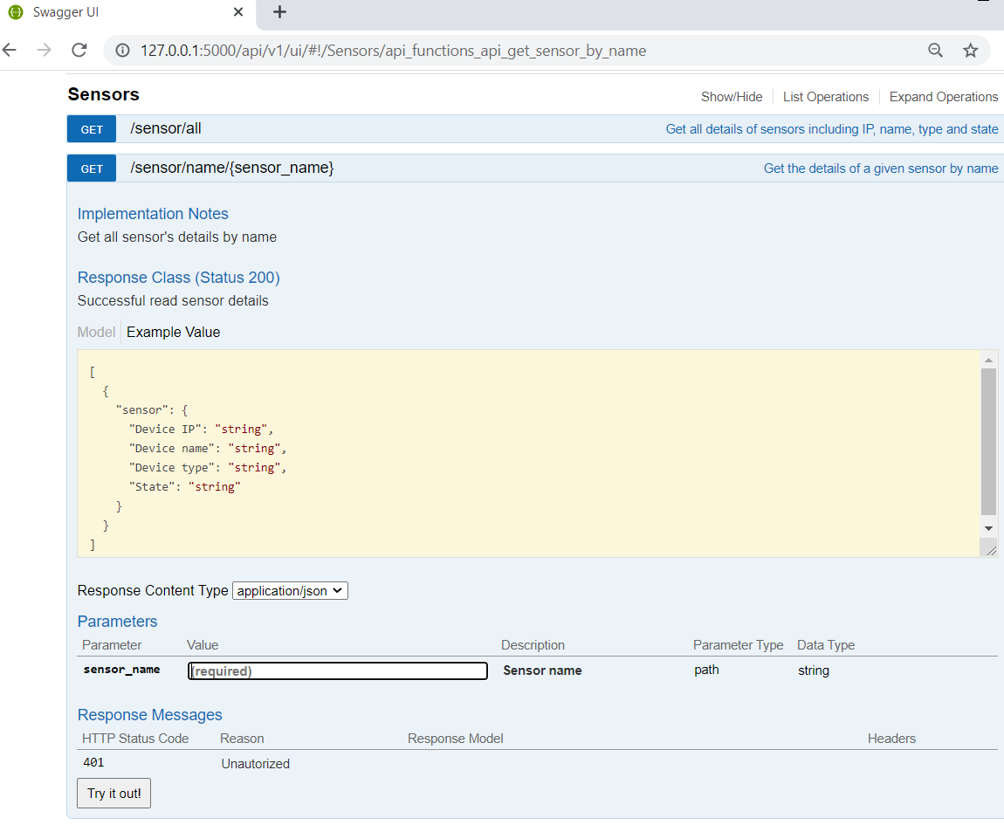
Swagger UI console
Allows you to validate your API doc
Allows users to navigate though API
Allows users to try API requests
In Connextion use path:
basePath+/ui
Where basePath is defined in YAML file

Slide 9
Demo

Slide 10

Congratulations ! ☺
We’ve finished the Python and API training !

Slide 11
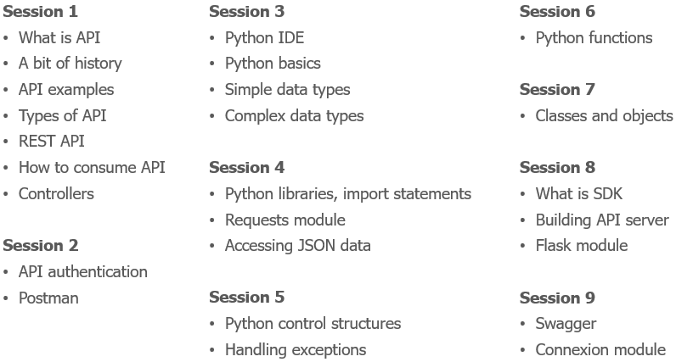
More than 9 hours of lessons

Slide 12
What we learned
What is API
A bit of history
API use cases and examples
Types of API
REST API
How to consume API
Webhooks
Controllers
REST API Authentication
Basic authentication
Bearer authentication
API Keys
OAuth
Cookies
Custom headers
Combination of methods
Practice – API authentication with cURL
Postman interface
Main features
Postman practice
Why Python
IDE - Integrated Development Environment
Python virtual environments
Variables
Simple data types – integer, float, string, bool
Data types conversion, output, f-strings
Complex data types – dictionaries and lists
Import packages
Python requests library
Making API requests
JSON
Control structures
If-else, if – elif -else
While
For
Using control structures for handling API responses
Handling exceptions
Recap from last session – nested data structures
Accessing JSON data
Python functions
Functions in programming languages
Functions in Python
Function arguments
Position vs named arguments
Variable scope
Return values
Classes
Class instances – Objects
Class properties/attributes
Class methods
OOP – Object-oriented programming
SDKs – Software Development Kits
Using SDKs in Python
SDK examples
Building simple API server
Recap from Session 1: Controllers
Northbound and Southbound APIs
Intro to Flask
Defining routes
Returning JSON data
Reading data from files
Filtering data - List comprehension
Open API specification Connexion module

Slide 13
Please provide your feedback
Was the training useful for you?
What you liked and (most importantly) what you didn’t?
What content would you add or remove?
Any specific topics you found boring and interesting?
Were there enough details and examples?
Would you prefer more practical exercises?
Would you prefer shorter session, or more often (2 times a week) ?
Would you be interested in further trainings, what topics?
Let’s connect in LinkedIn:
https://www.linkedin.com/in/alexander-zyuzin/

Slide 14


Thank you for participating !
Stay curious and keep learning ☺

